Slide 1
ROUTING PROTOCOL -by Hitesh Nautiyal

Slide 2
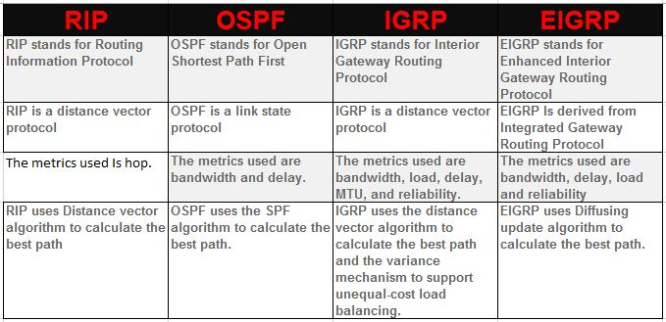
Difference Between Routing Protocols :-

Slide 3
What is BGP ?
BGP (Border Gateway Protocol) is the protocol that enables the global routing system of the internet. It manages how packets get routed from network to network by exchanging routing and reachability information among edge routers.
BGP enables peering to send packets between autonomous systems (ASes), which are networks managed by a single enterprise or service provider. Together, these ASes make up the public internet.
BGP creates network stability by guaranteeing that routers can adapt to route failures. When one path goes down, BGP quickly finds a new path. BGP makes routing decisions based on paths, defined by rules or network policies set by network administrators.

Slide 4
How does BGP work?
Each router maintains a routing table that controls how packets are directed. The BGP process on the router generates routing table information, which is based on the following factors:
Incoming information from other routers.
Information in the BGP routing information base (RIB), which is a data table stored on a server on the BGP router.
The RIB contains information both from directly connected external peers and internal peers. The RIB contains policies for what routes should be used and what information should be published, and it continually updates the routing table as changes occur.

Slide 5
BGP routing basics
BGP sends updated router table information only when something changes, and it sends only the affected information. BGP has no automatic discovery mechanism, which means network admins must manually set up connections between peers, with peer addresses programmed in at both ends.
BGP makes best-path decisions based on attributes that include the following:
Highest weight.
Current reachability.
Hop counts.
Local preference.
Oldest path.
In situations where multiple paths are available -- as within a major hosting facility -- BGP policies communicate an organization's preferences for what path traffic should follow in and out. BGP community tags can control route advertisement behavior among peers.
BGP in networking is based on the TCP/IP model. It operates on the Open Systems Interconnection transport layer (Layer 4) to control the network layer (Layer 3).
As described in RFC 4271 and ratified in 2006, the current version of BGP-4 supports both IPv6 and Classless Inter-Domain Routing (CIDR), which enables the continued viability of IPv4. Using CIDR enables a network to have more network addresses than with the current IP address assignment scheme.

